Slide 1
OOM Mini Project:
Airline Booking System
Presented by: Group 14
Sarthak Madhamshettiwar • IIT2021023 (Sec-C)
Saikat Sadhukhan • IIT2021261 (Sec-C)
Piyush Gawade • IIB2021041 (Sec-C)
Guided By:
Proff. O.P. Vyas Sir
Bagesh Kumar Sir, Ayush Sinha Sir and Harshit Gupta Sir

Slide 2
Abstract
The main objective of this application is to decrease the manual mistakes engaged in the commercial airline booking process and create it practical for the clients to book the routes as when they require such that they can implement this application to create bookings, change bookings or terminate a particular booking.
The name of the application is “AIRLINE BOOKING SYSTEM”. This application provides alternatives for watching different routes available with different timings for a particular time frame and provides clients with the service to publication a admission, change or terminate a particular reservation but it does not offer the clients with information of price of the admission and it does not allow the client to alter a particular aspect of his reservation and he/she can change all his information. The software keep generating timely message regarding schedule related updates to users.

Slide 3
Technology used
Accomplishment 1
Core Java
Java Swing (GUI)
Apache NetBeans IDE 15
Frontend:
Backend:2
SQL Database
php-Admin
IDE:

Slide 4
Key Objectives
User can :-
Register/ Login
Book Ticket
Check Flight details
Cancel Ticket
Admin can:-2
Login
Enter/ Edit Airline details
View Information of all passengers
Check Payment details

Slide 5
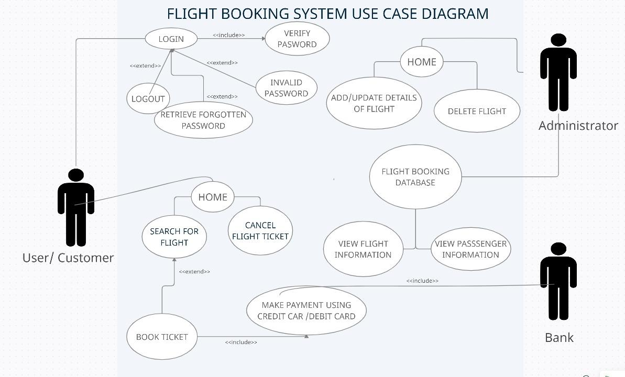
UML Diagrams:
Use-Case Diagram

Slide 6
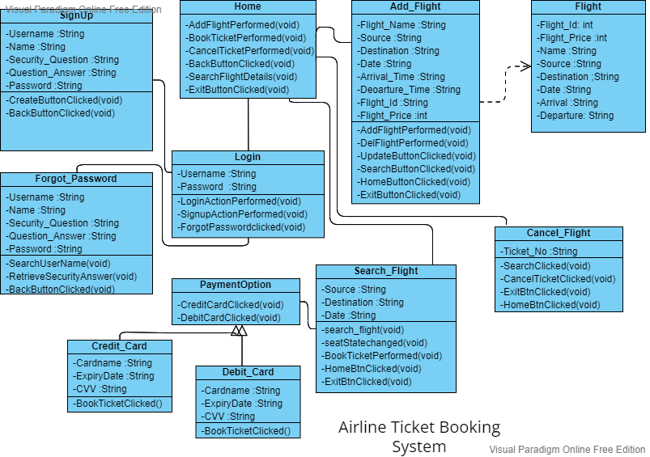
Class Diagram

Slide 7
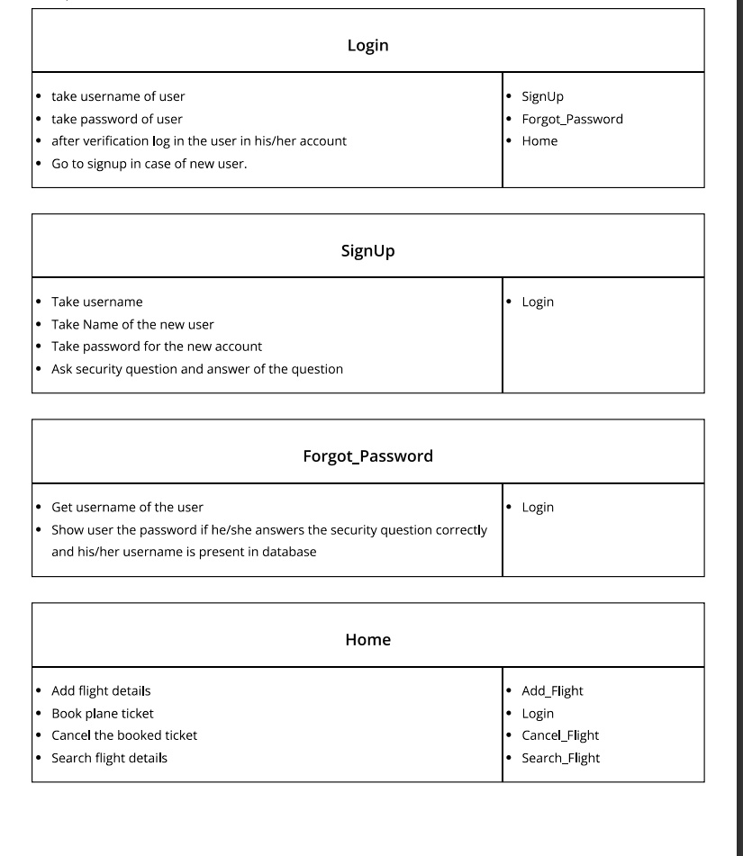
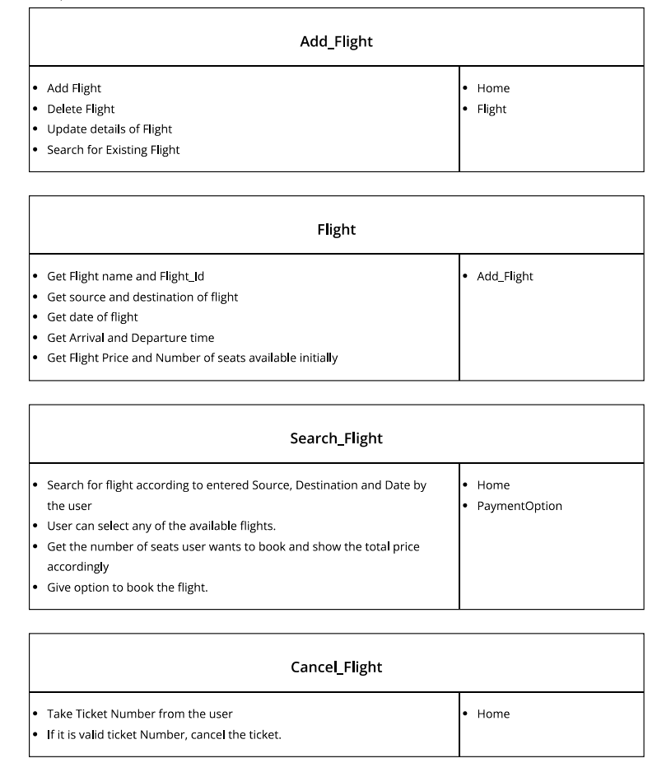
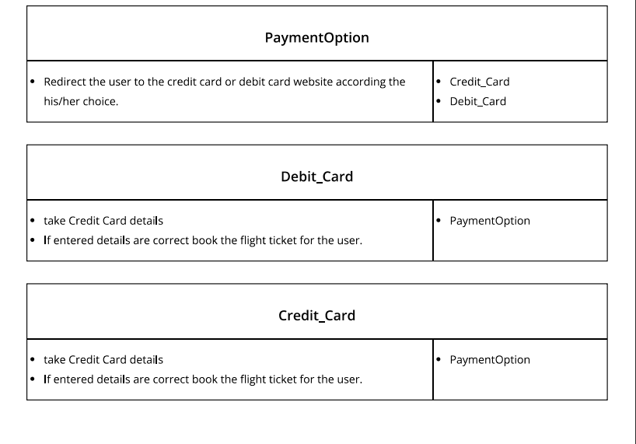
CRC Diagram

Slide 8
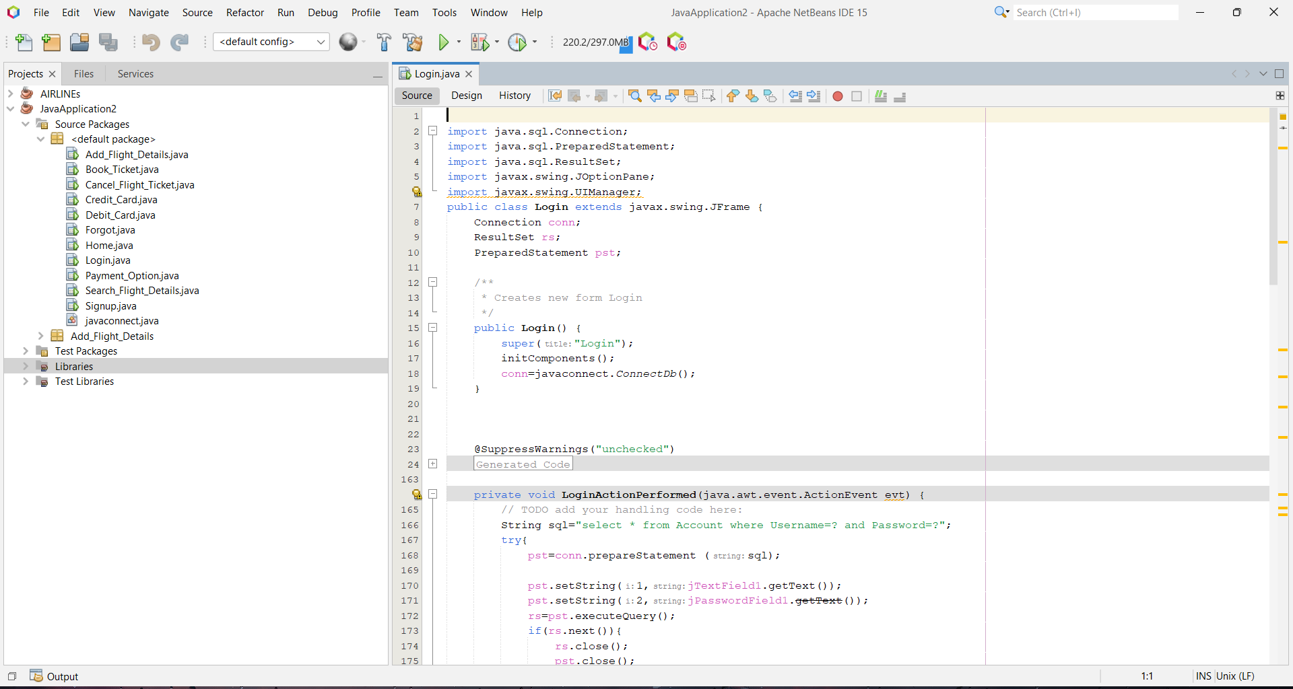
Code:
Full Code Repo: https://github.com/PiyushGG18/Airline-Booking.git

Slide 9
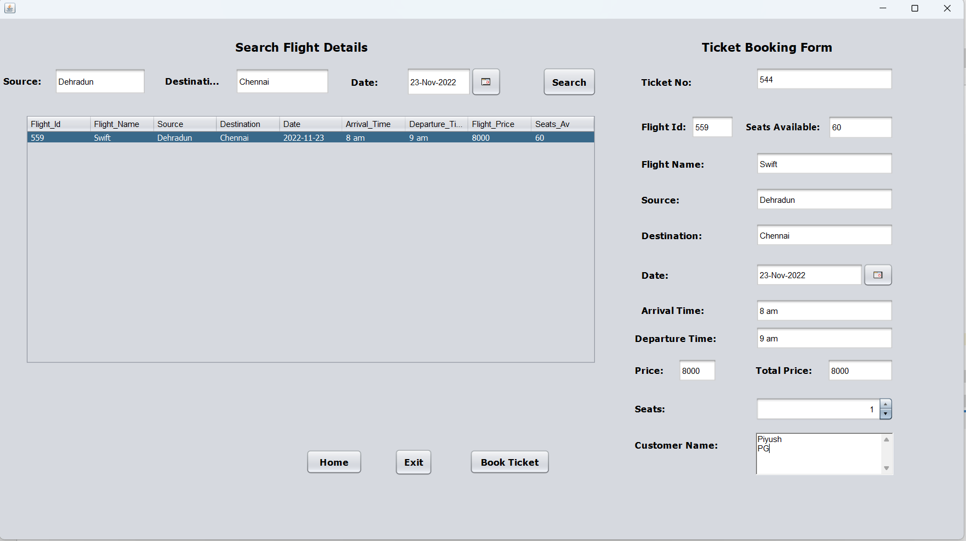
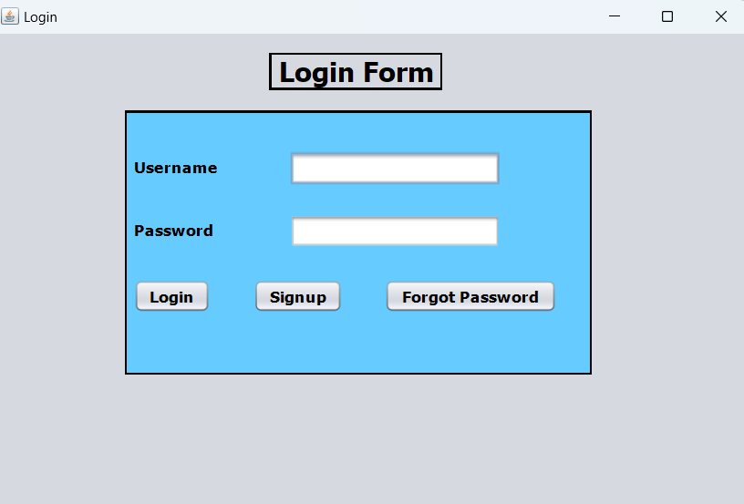
Project Screenshots

Slide 10
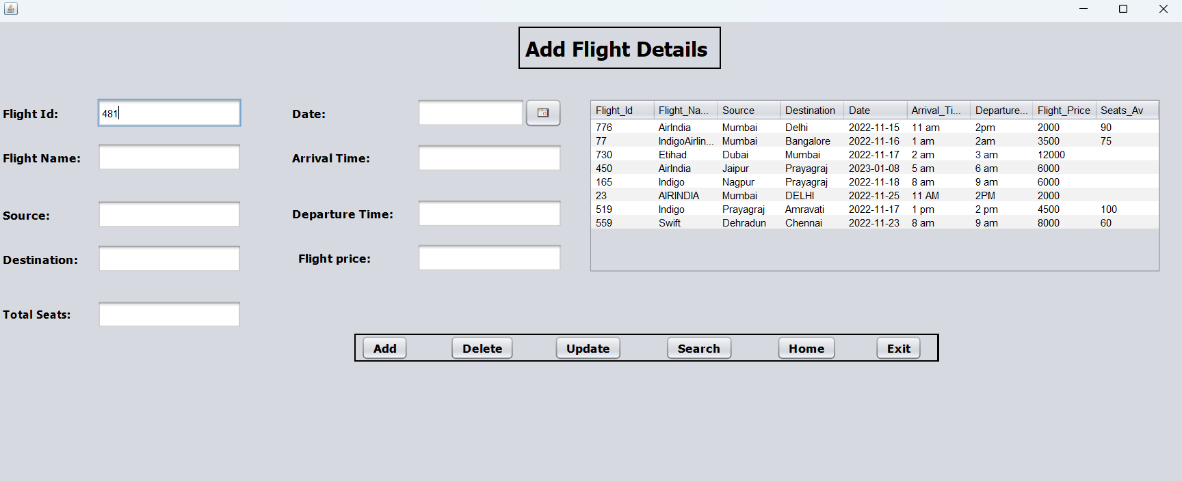

Slide 11
References
https://www.geeksforgeeks.org/database-objects-in-dbms/?ref=lbp
https://www.geeksforgeeks.org/structured-query-language/?ref=lbp
https://stackoverflow.com/questions/74459117/how-insert-multiple-file-in-database-in-same-row
https://stackoverflow.com/questions/74459052/sql-server-trying-to-rephrase-a-query
https://www.javatpoint.com/java-swing

